Slide 1
Activity 01: Data Cleaning & Visuals
SISMID Lab
July 22 through July 24, 2026
A Human – AI Teaming Approach to Infectious Disease Modeling

Slide 2

General Housekeeping
Any slide with this icon contains the goals and
expected outputs for the activity. All outputs listed in
the tables on these slides should be uploaded to the
course GitHub repository for review.
Any slide with this icon indicates that it is time to complete a hands-on activity. Carefully follow the instructions provided, complete the required task, and verify your results.

Slide 3
Lab Timeline
We are here
Activity 1
Activity 2
Activity 3
Activity 4
Data Cleaning &
Visuals
Data
Exploration
Modeling & Forecasting
Evaluation
Activity 5 Incremental Revisions
Notes:
Add in time/day/session when known

Slide 4
Activity Roadmap
The steps you’ll work through to clean the data with your AI agent
1
2
3
4
Review the Rules
Build the Agent
Generate the Script
Run & Commit
Open rules.md and read the cleaning rules you’ll hand to your agent — no edits needed this time.
Prompt Copilot (or AI of your choosing) to turn rules.md into agents.md, the instructions your agent will follow.
Use agents.md to have Copilot (or AI of your choosing) write the 01_cleaning.R data-cleaning script.
Run the script, check the cleaned CSV and epicurve, then commit your results to GitHub (We will do this together).
You make every decision — the AI just writes the code.

Slide 5
Your Task
Using the provided rules.md file as a starting point, you will need to create an agents.md file, the initial script to clean the data, and the actual cleaned data file. Descriptions of each can be found below.
Activity Output | Description
agents.md | Instructions for the AI assistant (the "agent"). It tells the AI who it is, what job to do, and what rules to follow. You update this file to change how the AI behaves.
01_cleaning.R | The R code the AI writes for you. It opens the raw data, keeps the US flu numbers, and tidies everything into a clean table.
epicurve_us_flu_admissions.png | The plot of weekly US flu admissions over time — your visual check that the cleaned data looks right before moving on.
cleaned_flu_admissions.csv | The finished data: one row per week with the date, location, and flu admission count, ready to use.

Slide 6
Data Cleaning: The Rules
These rules are provided in the rules.md file. Your agent will follow them to generate 01_cleaning.R.
1
Load the data
2
Filter to US only
Read the Weekly Hospital Respiratory Data (HRD) Metrics by Jurisdiction.csv from the data/ folder using readr.
Column: 'Geographic aggregation' → keep rows where value is "USA".
3
Select target column
4
Reshape to 3 cols
Keep only the `Total Influenza Admissions` column. Drop all other columns, including those for RSV and COVID-19.
Rename and restructure the data to: week, location ("US"), value.
5
Format dates
6
Save output
Convert week ending date to R Date object. Sort ascending.
Write cleaned_flu_admissions.csv and the epicurve to the appropriate subfolder in output/.

Slide 7


Reminder: Rules Document vs AI Agent
rules.md
agents.md
AI
generates
Written by YOU
Generated by AI
Human-readable specifications
Describes WHAT the pipeline should do
You edit this to improve results
AI-readable agent instructions
Describes HOW to execute the pipeline
The intermediary between you and code
At the end of the day, you are still the expert making the decisions.

Slide 8
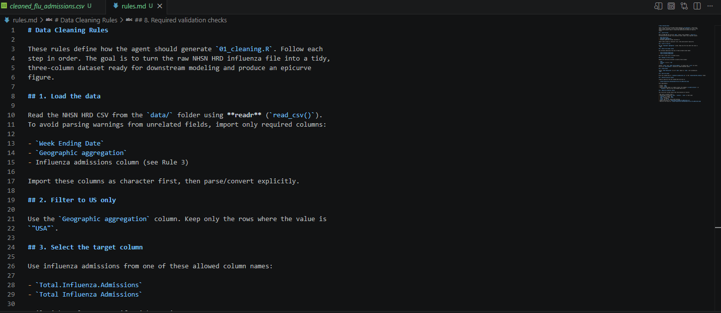
rules.md Starting Place
We do not need to make any changes to the rules.md file for this activity. During future activities, we will be adding our own rules to this document and re-generate the agents.md file. For now, this is included as an example of how to structure the rules document as we build it up.

Slide 9
Prompting Your Agent
This activity will require two prompts: One to build the agent and one to generate code.
Step 1: Generate the agent
Using rules.md, generate an agent file and save it as agents.md
Step 2: Generate the R script
Using agents.md, generate a Data Cleaning script and save as scripts/01_cleaning.R
The rules doc is what YOU control. The agent is what the AI builds from it. The scripts are what the agent produces.
Notes:
Copy and paste as to – ADDRESS ISSUES WITH HALLICUTE

Slide 10
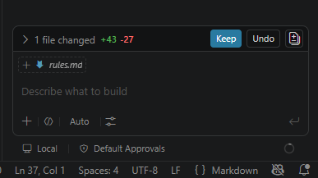
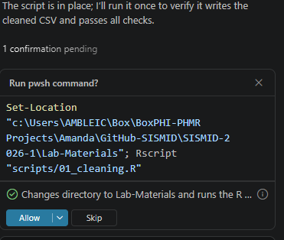
Some Tips
Each time we make a change to a file via the integrated AI, the changes made from file version to file version are tracked. Each time you make a change, you will want to see what the AI did, and if happy with the change, click Keep. This will change the file in your working directory to match that with the changes made by the AI.
The AI may try to run the code directly within the chat window. This can be buggy at times, so we suggest skipping this suggestion and running locally (via the editor window). If you decide to run via the chat window, you may be given a series of prompts until R is found on your local machine. To skip and run locally, click Skip.

Slide 11
Now it’s your turn!
Please complete the following steps and together we will commit all results to the course GitHub.
1
Open the project folder and double check that it contains data/Weekly Hospital Respiratory Data (HRD) Metrics by Jurisdiction.csv
2
Open the rules.md file and read Data Cleaning Rules. Make sure all rules match those specified on the earlier slide. If you have any questions, please let us know.
3
Prompt Copilot (or AI of your choosing) to generate the agents.md file from the rules document (Hint: copy the Step 1 prompt from Slide 9).
4
Use the agents.md file and Copilot (or AI of your choosing) to generate scripts/01_cleaning.R (Hint: copy the Step 2 prompt from Slide 9).
5
Run the script, check the output CSV has 3 columns: week, location, value and you have the epicurve of the data.

Slide 12
Expected Process & Results

Slide 13
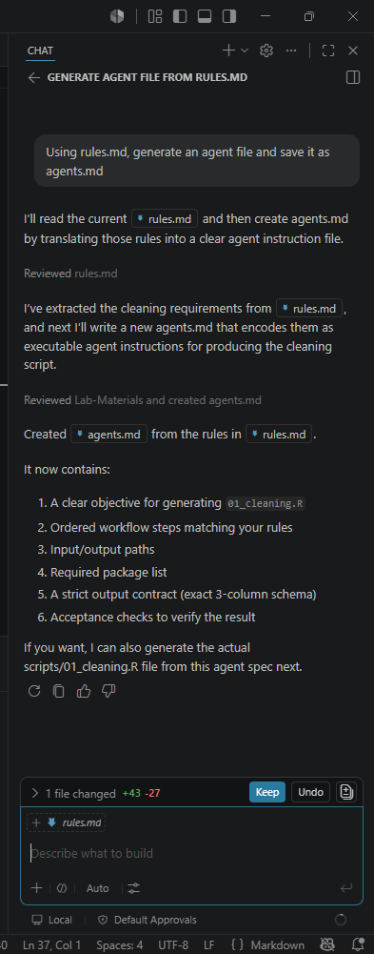
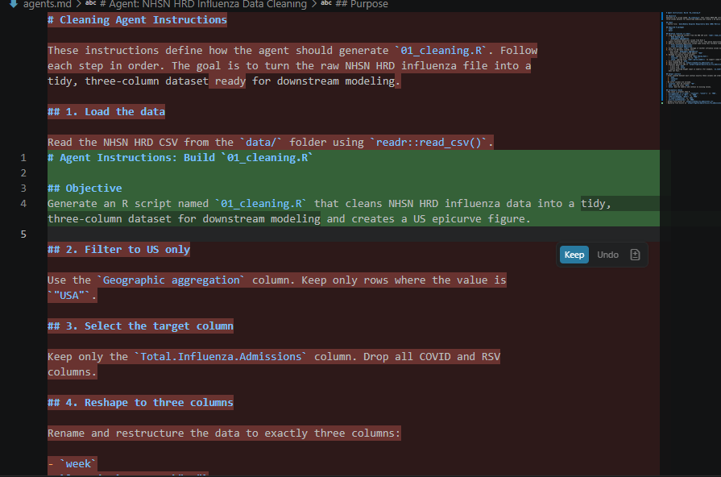
agents.md File

Slide 14
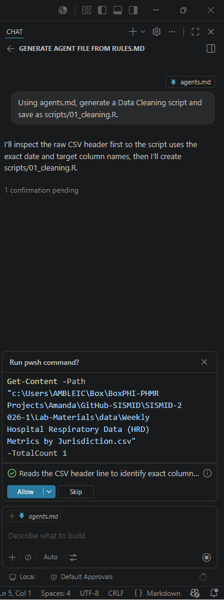
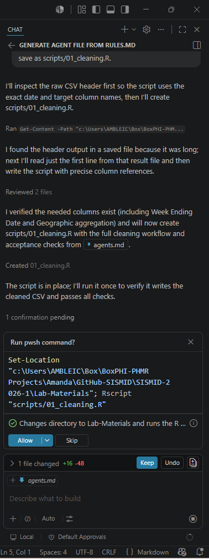
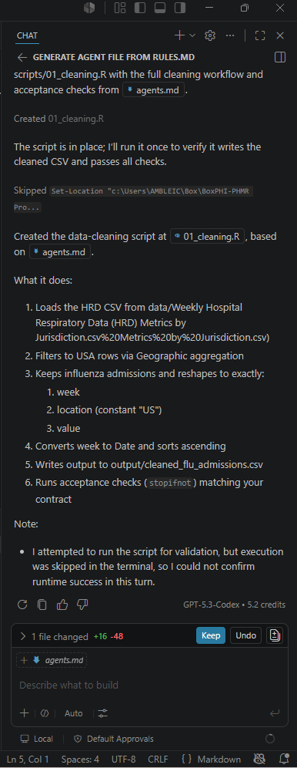
R Script
When generating the 01_cleaning.R script, the AI may prompt you multiple times at many steps from your initial message to the script.
For example, in the initial picture, it is asking permission to look at the data. In the second picture, it is asking permission to run the script (Skipped for this activity; see earlier slide).
The key is to read WHY you are being asked a question before clicking Allow or Keep.

Slide 15
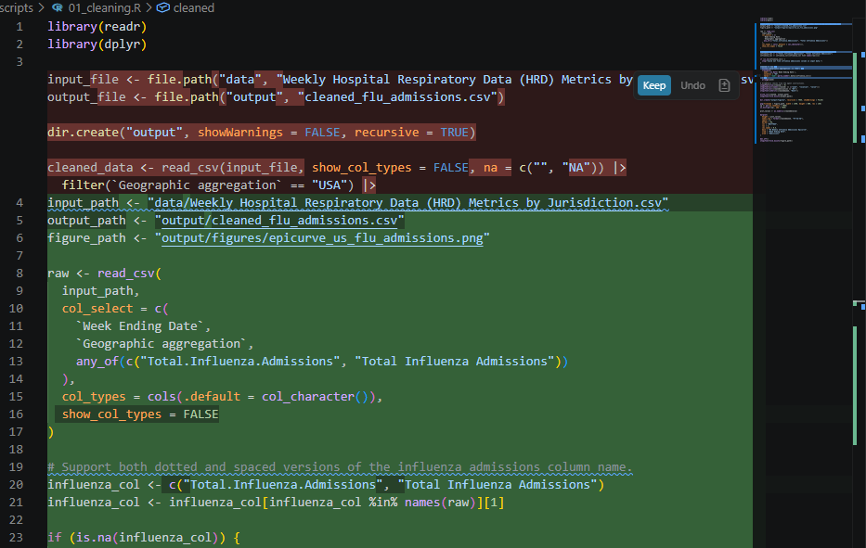
01_cleaning.R File

Slide 16
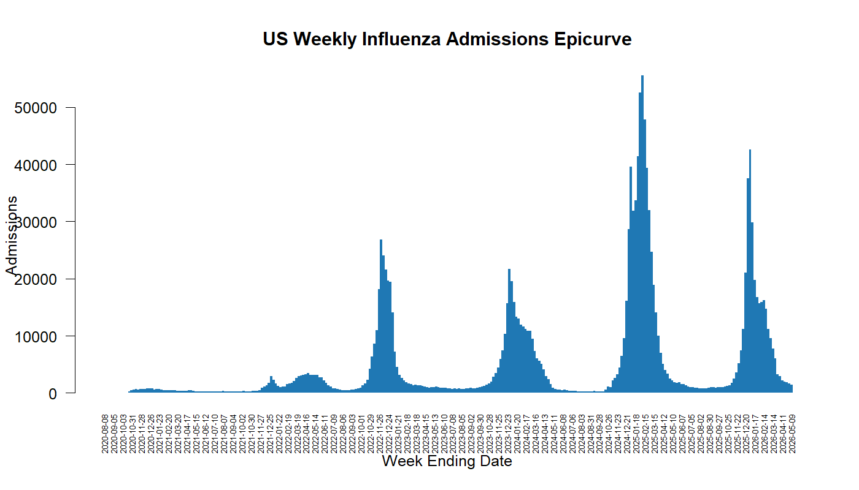
Resulting Epicurve

Slide 17
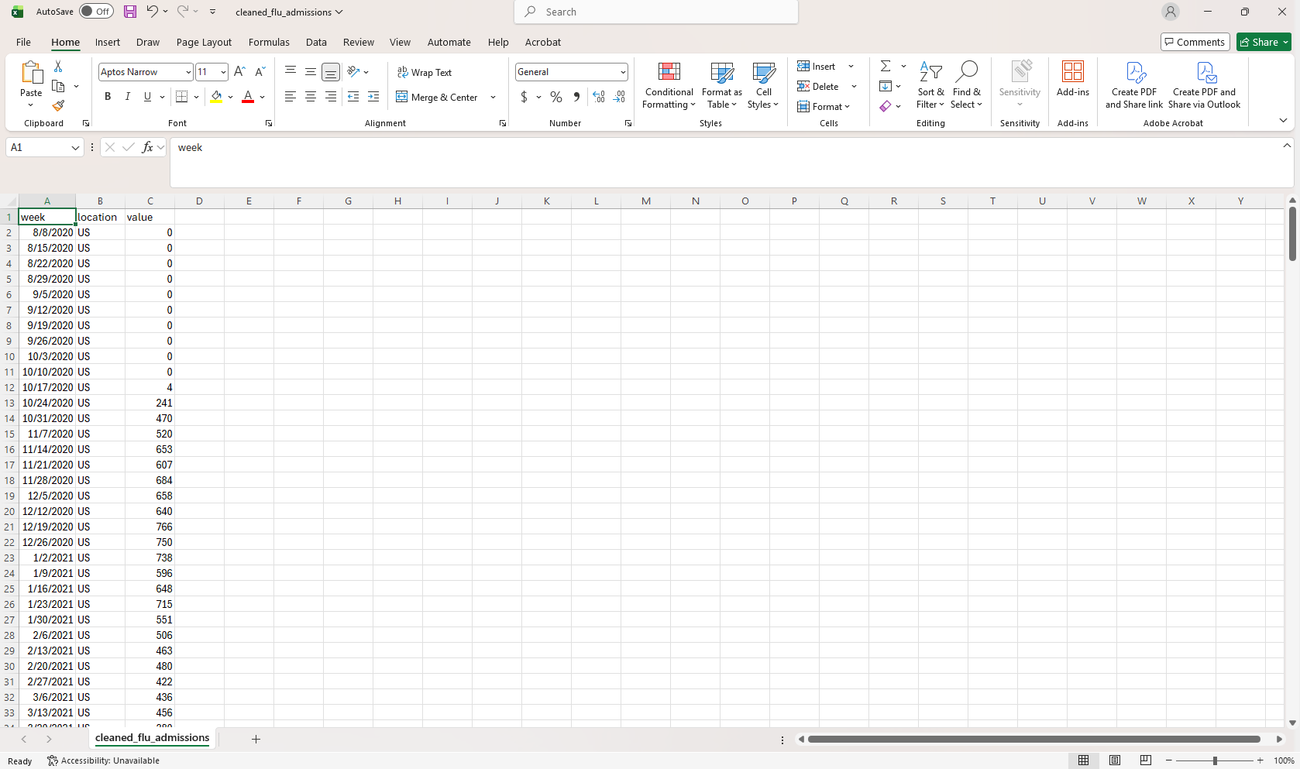
Resulting Dataset: cleaned_flu_admissions.csv

